Slide 1




Slide 2


Optimizing Workforce Efficiency: A 10-Slide Analysis of Employee Performance

Slide 3

Introduction to Workforce Efficiency
is crucial for enhancing overall
. This
presentation will explore various
strategies and metrics that can help organizations maximize productivity and engagement. Understanding these elements will lead to a more effective and motivated workforce.

Slide 4




Understanding Employee Performance
Employee performance is influenced by various factors including
, , and
. Identifying these
factors can help organizations tailor their approaches to enhance productivity and job satisfaction, ultimately leading to better
outcomes.

Slide 5




Setting Clear Objectives
Establishing is essential for guiding employee efforts and measuring success. When employees understand their goals, they are more likely to align their tasks with organizational priorities, resulting in improved and accountability.

Slide 6

Implementing Performance Metrics
Using allows
organizations to quantitatively assess employee contributions. Key performance indicators (KPIs) should be aligned with
business goals, enabling managers to identify high performers and those needing support, fostering a culture of continuous improvement.

Slide 7

Fostering a Positive Work Environment
A is vital
for enhancing employee morale and productivity. Encouraging open communication, providing support, and recognizing achievements can significantly impact employee satisfaction and overall
performance.

Slide 8


Training and Development Programs
Investing in
helps employees enhance their skills and adapt to changing job requirements.
Organizations that prioritize professional
growth often see increased
and retention rates, leading to improved performance.

Slide 9


Leveraging Technology for Efficiency
Utilizing can streamline workflows and enhance communication among teams. Tools like project management software and collaboration platforms can reduce redundancies and improve overall efficiency, allowing employees to focus on their core tasks.

Slide 10
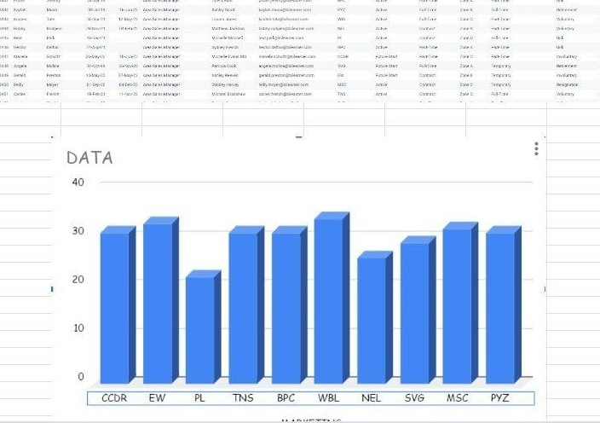

Conclusion: Enhancing Workforce Efficiency
In conclusion, optimizing workforce efficiency requires a multifaceted approach that includes
, effective metrics, and a supportive environment. By implementing these
strategies, organizations can significantly
enhance employee performance and drive success.

Slide 11
Thanks!

